Slide 1
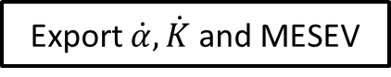
START
Assign the parameters
Initialize the population
VMD
Compute MESEV
Implement the selection, crossover and mutation operators
Use new individuals to update population
No
Is the MESEV min?
Yes
Export $\dot{α},\dot{K}$ and MESEV
END

Slide 2
Raw signal
Signal filtering
EEMD or VMD
Signal processing
To transform the time domain signals into a series of IMFs.
Energy Ratio or
Sample Entropy or
Correlation Coefficient
IMF selection
To filter the unrelated IMFs and reconstruct the significate IMFs.
Feature extraction
To extract distinguishable features form the reconstructed signals.
ASD
MFDFA
TDSA
Classification
To train an analytic model for predicting engine knock.
To verify the classification ability.
ELM/KELM/SBELM

Slide 3
Non-knock signal
Knock signal

Slide 4
a)
g)
b)
h)
c)
i)
d)
j)
e)
k)
f)
l)

Slide 5
EEMD
Correlation Coefficient | IMF1 | IMF2 | IMF3 | IMF4 | IMF5 | IMF6 | IMF7 | IMF8 | IMF9 | IMF10 | IMF11 | T
Signal A | 0.3528 | 0.3171 | 0.3046 | 0.2839 | 0.2621 | 0.2712 | 0.4645 | 0.7238 | 0.2879 | 0.1597 | 0.1769 | 0.3277
Signal B | 0.3370 | 0.3008 | 0.2911 | 0.2785 | 0.2751 | 0.2581 | 0.4354 | 0.7524 | 0.1356 | 0.1082 | 0.1100 | 0.2984
Signal C | 0.3898 | 0.3538 | 0.3322 | 0.3315 | 0.3193 | 0.2556 | 0.3435 | 0.6315 | 0.3140 | 0.0868 | 0.1547 | 0.3193
Signal D | 0.0320 | 0.1328 | 0.2392 | 0.3343 | 0.3569 | 0.4390 | 0.7827 | 0.5126 | 0.1265 | 0.0160 | 0.0168 | 0.2717
Energy Ratio | IMF1 | IMF2 | IMF3 | IMF4 | IMF5 | IMF6 | IMF7 | IMF8 | IMF9 | IMF10 | IMF11 | T
Signal A | 0.1047 | 0.0488 | 0.0402 | 0.0302 | 0.0298 | 0.0264 | 0.0377 | 0.3782 | 0.0190 | 0.0258 | 0.0003 | 0.0674
Signal B | 0.0978 | 0.0420 | 0.0360 | 0.0331 | 0.0297 | 0.0258 | 0.0305 | 0.5008 | 0.0217 | 0.0213 | 0.0000 | 0.0762
Signal C | 0.1378 | 0.0668 | 0.0475 | 0.0462 | 0.0438 | 0.0302 | 0.0311 | 0.3125 | 0.0426 | 0.0167 | 0.0008 | 0.0706
Signal D | 0.0003 | 0.0043 | 0.0211 | 0.0418 | 0.0435 | 0.0890 | 0.4685 | 0.0665 | 0.0069 | 0.0090 | 0.0003 | 0.0683
Sample Entropy | IMF1 | IMF2 | IMF3 | IMF4 | IMF5 | IMF6 | IMF7 | IMF8 | IMF9 | IMF10 | IMF11 | T
Signal A | 1.6746 | 1.1505 | 0.6493 | 0.5627 | 0.3784 | 0.1439 | 0.0494 | 0.0186 | 0.0068 | 0.0029 | 0.0018 | 0.4217
Signal B | 1.7028 | 1.1791 | 0.6445 | 0.5704 | 0.3557 | 0.1672 | 0.0538 | 0.0171 | 0.0061 | 0.0025 | 0.0019 | 0.4274
Signal C | 1.6518 | 1.1182 | 0.6462 | 0.5587 | 0.3074 | 0.1532 | 0.0561 | 0.0194 | 0.0074 | 0.0042 | 0.0018 | 0.4113
Signal D | 2.1221 | 0.7450 | 0.6189 | 0.5016 | 0.3023 | 0.1046 | 0.0299 | 0.0182 | 0.0099 | 0.0019 | 0.0019 | 0.4051
s₆ | Correlation Coefficient | Energy Ratio | Sample Entropy
IMF₁ | 0.3898 | 0.1378 | 1.6518
IMF₂ | 0.3538 | 0.0668 | 1.1182
IMF₃ | 0.3322 | 0.0475 | 0.6462
IMF₄ | 0.3315 | 0.0462 | 0.5587
IMF₅ | 0.3193 | 0.0438 | 0.3074
IMF₆ | 0.2556 | 0.0302 | 0.1532
IMF₇ | 0.3435 | 0.0311 | 0.0561
IMF₈ | 0.6315 | 0.3125 | 0.0194
IMF₉ | 0.3140 | 0.0426 | 0.0074
IMF₁₀ | 0.0868 | 0.0167 | 0.0042
IMF₁₁ | 0.1547 | 0.0008 | 0.0018
T | 0.3193 | 0.0706 | 0.4113

Slide 6
f₀
f₂
2f₀
2f₂
3f₀
3f₂
4f₀
4f₂
5f₀
5f₂
6f₀
6f₂
f₁
f₃
2f₁
2f₃
3f₁
3f₃
4f₁
4f₃
5f₁
5f₃
6f₁
a)
b)
c)
d)
e)
f)
g)
h)

Slide 7
f₀
f₁
f₂
2f₀
2f₂
3f₀
3f₂
4f₀
4f₂
5f₀
5f₂
6f₀
6f₂
f₃
2f₁
2f₃
3f₁
3f₃
4f₁
4f₃
5f₁
5f₃
6f₁
a)
b)
K = 10, α=1500
c)
d)
K = 10, α=5000
e)
f)
K = 10, α=10000
g)
h)
K = 5, α=1500
i)
j)
K = 20, α=1500
k)
l)

Slide 8
a)
f)
b)
g)
c)
h)
d)
i)
e)
j)

Slide 9
VMD
Correlation Coefficient | IMF1 | IMF2 | IMF3 | IMF4 | IMF5 | IMF6 | IMF7 | IMF8 | IMF9 | IMF10 | T
Signal A | 0.8556 | 0.3308 | 0.2422 | 0.2092 | 0.1893 | 0.1675 | 0.1537 | 0.1483 | 0.1720 | 0.1148 | 0.2583
Signal B | 0.8704 | 0.3064 | 0.2349 | 0.1961 | 0.1847 | 0.1715 | 0.1539 | 0.1439 | 0.1560 | 0.1066 | 0.2525
Signal C | 0.7790 | 0.3963 | 0.3051 | 0.2535 | 0.2338 | 0.2086 | 0.1954 | 0.1875 | 0.1934 | 0.1442 | 0.2897
Signal D | 0.8600 | 0.2332 | 0.0720 | 0.0523 | 0.2289 | 0.2399 | 0.1219 | 0.0953 | 0.4422 | 0.1366 | 0.2482
Energy Ratio | IMF1 | IMF2 | IMF3 | IMF4 | IMF5 | IMF6 | IMF7 | IMF8 | IMF9 | IMF10 | T
Signal A | 0.7116 | 0.0504 | 0.0216 | 0.0166 | 0.0126 | 0.0103 | 0.0088 | 0.0087 | 0.0177 | 0.0048 | 0.0863
Signal B | 0.7230 | 0.0441 | 0.0234 | 0.0151 | 0.0146 | 0.0115 | 0.0090 | 0.0078 | 0.0153 | 0.0048 | 0.0869
Signal C | 0.5632 | 0.0744 | 0.0356 | 0.0236 | 0.0215 | 0.0162 | 0.0147 | 0.0128 | 0.0190 | 0.0084 | 0.0790
Signal D | 0.6709 | 0.0341 | 0.0024 | 0.0014 | 0.0242 | 0.0199 | 0.0080 | 0.0040 | 0.1084 | 0.0096 | 0.0883
Sample Entropy | IMF1 | IMF2 | IMF3 | IMF4 | IMF5 | IMF6 | IMF7 | IMF8 | IMF9 | IMF10 | T
Signal A | 0.0544 | 0.5652 | 0.6091 | 0.5789 | 0.5911 | 0.5616 | 0.5620 | 0.5519 | 0.5721 | 0.6072 | 0.5253
Signal B | 0.0477 | 0.5730 | 0.6092 | 0.5684 | 0.5348 | 0.6011 | 0.5927 | 0.5824 | 0.5766 | 0.5914 | 0.5277
Signal C | 0.0645 | 0.5318 | 0.6086 | 0.5841 | 0.5775 | 0.5748 | 0.5362 | 0.5934 | 0.5911 | 0.5979 | 0.5260
Signal D | 0.0284 | 0.4668 | 0.5471 | 0.4956 | 0.4372 | 0.2887 | 0.5983 | 0.5922 | 0.1174 | 0.5898 | 0.4162
s₆ | Correlation Coefficient | Energy Ratio | Sample Entropy
IMF₁ | 0.7790 | 0.5632 | 0.0645
IMF₂ | 0.3963 | 0.0744 | 0.5318
IMF₃ | 0.3051 | 0.0356 | 0.6086
IMF₄ | 0.2535 | 0.0236 | 0.5841
IMF₅ | 0.2338 | 0.0215 | 0.5775
IMF₆ | 0.2086 | 0.0162 | 0.5748
IMF₇ | 0.1954 | 0.0147 | 0.5362
IMF₈ | 0.1875 | 0.0128 | 0.5934
IMF₉ | 0.1934 | 0.019 | 0.5911
IMF₁₀ | 0.1442 | 0.0084 | 0.5979
T | 0.2897 | 0.0790 | 0.5260

Slide 10
f₀
f₁
f₂
2f₀
2f₂
3f₀
3f₂
4f₀
4f₂
5f₀
5f₂
6f₀
6f₂
f₃
2f₁
2f₃
3f₁
3f₃
4f₁
4f₃
5f₁
5f₃
6f₁
a)
b)
c)
d)
e)
f)
g)
h)

Slide 11
f₀
f₂
2f₀
2f₂
3f₀
3f₂
4f₀
4f₂
5f₀
5f₂
6f₀
6f₂
f₁
f₃
2f₁
2f₃
3f₁
3f₃
4f₁
4f₃
5f₁
5f₃
6f₁
a)
b)
c)
d)
e)
f)

Slide 12
EEMD + Sample entropy
 |  | y_{mean} | y_{std} | y_{rms} | y_{peak} | y_{skew} | y_{kurt} | y_{crf} | y_{clf} | y_{sf} | y_{if}
Non-knock | A₁ | 3.37E-06 | 1.80E-03 | 0.002 | 0.010 | -0.112 | 4.508 | 5.318 | 8.438 | 1.315 | 6.991
 | A₂ | -1.95E-05 | 1.68E-03 | 0.002 | 0.010 | 0.124 | 5.063 | 5.842 | 9.351 | 1.322 | 7.721
 | A₃ | -2.46E-07 | 2.63E-03 | 0.003 | 0.011 | 0.017 | 3.000 | 4.002 | 5.913 | 1.253 | 5.014
 | A₄ | -2.26E-05 | 2.37E-03 | 0.002 | 0.010 | 0.004 | 3.046 | 4.108 | 6.124 | 1.258 | 5.169
 | B₁ | -9.61E-05 | 2.78E-03 | 0.003 | 0.020 | 0.151 | 5.609 | 7.186 | 11.518 | 1.326 | 9.527
 | B₂ | 2.68E-05 | 4.75E-03 | 0.005 | 0.030 | -0.098 | 4.153 | 6.326 | 9.556 | 1.274 | 8.060
 | B₃ | -4.29E-05 | 2.85E-03 | 0.003 | 0.022 | 0.073 | 5.251 | 7.651 | 12.234 | 1.323 | 10.124
 | B₄ | -3.61E-06 | 4.93E-03 | 0.005 | 0.036 | -0.242 | 4.882 | 7.204 | 11.008 | 1.285 | 9.257
 | C₁ | 1.17E-06 | 2.75E-03 | 0.003 | 0.029 | 0.103 | 7.403 | 10.688 | 17.640 | 1.354 | 14.470
 | C₂ | 7.20E-07 | 5.04E-03 | 0.005 | 0.037 | -0.273 | 4.680 | 7.435 | 11.426 | 1.289 | 9.582
 | C₃ | 1.74E-05 | 4.93E-03 | 0.005 | 0.037 | -0.266 | 4.537 | 7.492 | 11.530 | 1.289 | 9.656
 | C₄ | 7.53E-05 | 6.06E-03 | 0.006 | 0.043 | -0.308 | 4.789 | 7.037 | 10.916 | 1.296 | 9.122
Knock | A₅ | 2.65E-05 | 3.95E-03 | 0.004 | 0.015 | -0.077 | 3.258 | 3.912 | 5.859 | 1.266 | 4.951
 | A₆ | -6.38E-06 | 4.25E-03 | 0.004 | 0.019 | 0.029 | 3.032 | 4.422 | 6.573 | 1.256 | 5.553
 | A₇ | 1.26E-05 | 4.17E-03 | 0.004 | 0.021 | -0.117 | 3.602 | 4.958 | 7.498 | 1.274 | 6.316
 | A₈ | -2.68E-05 | 6.43E-03 | 0.006 | 0.038 | -0.030 | 4.981 | 5.860 | 9.334 | 1.321 | 7.740
 | B₅ | -1.86E-05 | 5.91E-03 | 0.006 | 0.033 | -0.024 | 3.750 | 5.566 | 8.491 | 1.281 | 7.130
 | B₆ | 3.49E-05 | 6.49E-03 | 0.006 | 0.035 | -0.060 | 3.576 | 5.393 | 8.145 | 1.272 | 6.859
 | B₇ | 5.37E-05 | 6.14E-03 | 0.006 | 0.041 | -0.083 | 4.094 | 6.722 | 10.165 | 1.275 | 8.573
 | B₈ | -5.01E-05 | 6.75E-03 | 0.007 | 0.033 | -0.095 | 3.702 | 4.895 | 7.431 | 1.276 | 6.249
 | C₅ | 3.49E-05 | 5.01E-03 | 0.005 | 0.040 | -0.319 | 5.517 | 7.989 | 12.289 | 1.292 | 10.319
 | C₆ | 2.18E-05 | 5.86E-03 | 0.006 | 0.036 | -0.168 | 4.404 | 6.153 | 9.447 | 1.288 | 7.926
 | C₇ | -1.18E-05 | 6.85E-03 | 0.007 | 0.035 | -0.075 | 3.693 | 5.084 | 7.781 | 1.281 | 6.513
 | C₈ | -1.38E-05 | 6.58E-03 | 0.007 | 0.039 | -0.013 | 3.985 | 5.872 | 9.002 | 1.285 | 7.544

Slide 13
OVMD + Sample entropy
 |  | y_{mean} | y_{std} | y_{rms} | y_{peak} | y_{skew} | y_{kurt} | y_{crf} | y_{clf} | y_{sf} | y_{if}
Non-knock | A₁ | 2.29E-07 | 9.87E-04 | 0.001 | 0.005 | 0.031 | 3.717 | 5.121 | 7.838 | 1.282 | 6.568
 | A₂ | -4.19E-08 | 9.70E-04 | 0.001 | 0.006 | 0.079 | 4.554 | 6.265 | 9.640 | 1.292 | 8.095
 | A₃ | -4.80E-07 | 2.60E-03 | 0.003 | 0.011 | -0.021 | 2.991 | 4.124 | 6.028 | 1.246 | 5.140
 | A₄ | -3.40E-07 | 2.36E-03 | 0.002 | 0.009 | 0.008 | 2.889 | 3.686 | 5.453 | 1.253 | 4.618
 | B₁ | 2.56E-06 | 0.002418 | 0.002 | 0.017 | 0.155 | 5.517 | 7.186 | 11.554 | 1.329 | 9.553
 | B₂ | 8.60E-07 | 4.11E-03 | 0.004 | 0.025 | -0.126 | 3.913 | 6.076 | 9.167 | 1.273 | 7.732
 | B₃ | 2.94E-06 | 2.47E-03 | 0.002 | 0.018 | 0.085 | 5.236 | 7.304 | 11.794 | 1.332 | 9.728
 | B₄ | 2.01E-06 | 3.72E-03 | 0.004 | 0.030 | -0.290 | 5.566 | 8.133 | 12.493 | 1.292 | 10.505
 | C₁ | 5.28E-07 | 2.09E-03 | 0.002 | 0.023 | 0.118 | 8.236 | 10.973 | 18.312 | 1.364 | 14.973
 | C₂ | 9.29E-07 | 3.87E-03 | 0.004 | 0.029 | -0.183 | 4.496 | 7.543 | 11.467 | 1.281 | 9.662
 | C₃ | -6.60E-06 | 4.39E-03 | 0.004 | 0.032 | -0.246 | 4.225 | 7.261 | 11.168 | 1.287 | 9.343
 | C₄ | -3.10E-06 | 4.39E-03 | 0.004 | 0.033 | -0.335 | 5.530 | 7.580 | 11.859 | 1.305 | 9.891
Knock | A₅ | -5.66E-07 | 4.11E-03 | 0.004 | 0.014 | -0.095 | 2.994 | 3.519 | 5.204 | 1.253 | 4.408
 | A₆ | 6.31E-08 | 3.28E-03 | 0.003 | 0.014 | 0.037 | 3.099 | 4.335 | 6.402 | 1.253 | 5.433
 | A₇ | -2.13E-06 | 3.29E-03 | 0.003 | 0.014 | -0.068 | 3.159 | 4.363 | 6.535 | 1.263 | 5.509
 | A₈ | -5.12E-07 | 4.05E-03 | 0.004 | 0.017 | 0.054 | 3.642 | 4.309 | 6.534 | 1.278 | 5.506
 | B₅ | 8.55E-06 | 5.29E-03 | 0.005 | 0.027 | -0.053 | 3.604 | 5.180 | 7.890 | 1.279 | 6.622
 | B₆ | 4.94E-07 | 4.91E-03 | 0.005 | 0.027 | -0.041 | 3.789 | 5.487 | 8.380 | 1.281 | 7.027
 | B₇ | -1.52E-06 | 5.45E-03 | 0.005 | 0.035 | -0.103 | 3.817 | 6.507 | 9.849 | 1.275 | 8.298
 | B₈ | 8.95E-06 | 6.06E-03 | 0.006 | 0.030 | -0.100 | 3.577 | 4.914 | 7.410 | 1.271 | 6.246
 | C₅ | 9.29E-07 | 3.87E-03 | 0.004 | 0.029 | -0.183 | 4.496 | 7.543 | 11.467 | 1.281 | 9.662
 | C₆ | -6.82E-06 | 5.21E-03 | 0.005 | 0.033 | -0.192 | 4.196 | 6.291 | 9.614 | 1.283 | 8.068
 | C₇ | 5.41E-06 | 6.16E-03 | 0.006 | 0.030 | -0.070 | 3.528 | 4.817 | 7.338 | 1.278 | 6.156
 | C₈ | 1.49E-05 | 5.33E-03 | 0.005 | 0.029 | 0.023 | 3.676 | 5.484 | 8.363 | 1.279 | 7.013

Slide 15
EEMD + Sample entropy
OVMD + Sample entropy
 |  | α | β | γ | δ | h
Non-knock | A₁ | 1.789 | 0.042 | 8.71E-04 | -4.20E-06 | 324.97
 | A₂ | 1.908 | 0.285 | 1.14E-03 | 1.96E-06 | 247.29
 | A₃ | 1.990 | 0.606 | 2.05E-03 | -1.95E-05 | 137.78
 | A₄ | 2.000 | 1.000 | 2.06E-03 | 6.37E-06 | 137.10
 | B₁ | 1.741 | -0.934 | 1.89E-03 | -1.70E-06 | 148.98
 | B₂ | 1.867 | 0.223 | 1.79E-03 | 2.23E-05 | 158.26
 | B₃ | 1.960 | -0.291 | 3.27E-03 | -1.62E-05 | 86.34
 | B₄ | 1.984 | -1.000 | 3.34E-03 | 2.36E-05 | 84.39
 | C₁ | 1.788 | 0.510 | 1.79E-03 | 1.32E-05 | 157.87
 | C₂ | 1.833 | 0.735 | 1.72E-03 | 1.80E-05 | 163.76
 | C₃ | 1.925 | -0.150 | 3.30E-03 | 1.95E-06 | 85.43
 | C₄ | 1.976 | -1.000 | 3.34E-03 | -8.62E-06 | 84.51
Knock | A₅ | 1.813 | 0.007 | 2.72E-03 | 5.52E-05 | 104.07
 | A₆ | 1.942 | 0.124 | 2.61E-03 | 1.54E-05 | 107.97
 | A₇ | 1.968 | 0.554 | 2.84E-03 | -2.48E-06 | 99.52
 | A₈ | 2.000 | 1.000 | 3.38E-03 | 2.46E-05 | 83.37
 | B₅ | 1.909 | -0.250 | 4.08E-03 | 2.77E-05 | 69.26
 | B₆ | 1.948 | -0.406 | 3.99E-03 | -2.27E-05 | 70.81
 | B₇ | 1.958 | -0.498 | 4.73E-03 | -1.47E-05 | 59.68
 | B₈ | 1.978 | -0.125 | 4.56E-03 | -1.74E-05 | 61.84
 | C₅ | 1.930 | -0.652 | 4.05E-03 | 2.57E-05 | 69.68
 | C₆ | 1.952 | -0.744 | 4.59E-03 | -3.37E-05 | 61.44
 | C₇ | 1.948 | 0.251 | 4.02E-03 | -4.23E-06 | 70.19
 | C₈ | 1.943 | -0.339 | 3.23E-03 | 2.83E-05 | 87.46
 |  | α | β | γ | δ | h
Non-knock | A₁ | 2.000 | -1.000 | 1.90E-03 | -2.86E-05 | 148.49
 | A₂ | 1.957 | -0.112 | 2.32E-03 | 1.60E-05 | 121.85
 | A₃ | 1.847 | 0.154 | 1.02E-03 | 4.39E-05 | 276.92
 | A₄ | 2.000 | 1.000 | 2.06E-03 | 6.37E-06 | 137.10
 | B₁ | 1.968 | -1.000 | 2.91E-03 | -1.89E-05 | 96.822
 | B₂ | 1.951 | -0.448 | 2.95E-03 | 5.02E-07 | 95.592
 | B₃ | 1.805 | 0.076 | 1.29E-03 | 1.91E-06 | 218.592
 | B₄ | 1.977 | 0.609 | 2.63E-03 | 3.54E-05 | 107.482
 | C₁ | 1.966 | -1.000 | 2.96E-03 | -3.73E-05 | 95.348
 | C₂ | 1.793 | -0.389 | 1.49E-03 | -4.61E-05 | 190.229
 | C₃ | 1.828 | 0.079 | 1.30E-03 | 1.28E-05 | 218.106
 | C₄ | 1.795 | 0.529 | 1.55E-03 | 7.55E-05 | 181.925
Knock | A₅ | 1.990 | -1.000 | 3.30E-03 | -1.48E-05 | 85.47
 | A₆ | 1.972 | -0.173 | 3.12E-03 | 1.50E-05 | 90.35
 | A₇ | 1.976 | 0.068 | 2.99E-03 | 3.95E-05 | 94.25
 | A₈ | 1.988 | 1.000 | 3.33E-03 | 7.06E-06 | 84.79
 | B₅ | 1.964 | -1.000 | 4.05E-03 | 4.44E-05 | 69.71
 | B₆ | 1.927 | -0.523 | 4.08E-03 | 2.03E-06 | 69.15
 | B₇ | 1.943 | -0.305 | 4.52E-03 | 7.81E-06 | 62.40
 | B₈ | 1.976 | 0.627 | 4.60E-03 | -9.65E-06 | 61.27
 | C₅ | 1.952 | -1.000 | 3.56E-03 | -5.84E-05 | 79.223
 | C₆ | 1.926 | -0.295 | 3.04E-03 | -1.30E-05 | 92.928
 | C₇ | 1.929 | 0.013 | 2.99E-03 | 1.93E-05 | 94.392
 | C₈ | 1.962 | 0.163 | 4.08E-03 | 2.05E-05 | 69.223

Slide 17
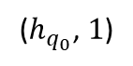
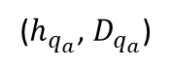
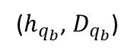
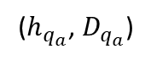
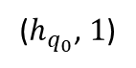
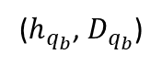
✖
($h_{q_{0}}$, $1$)
✖
($h_{q_{0}}$, $1$)
✖
($h_{q_{a}}$, $D_{q_{a}}$)
($h_{q_{a}}$, $D_{q_{a}}$)
✖
✖
($h_{q_{b}}$, $D_{q_{b}}$)
($h_{q_{b}}$, $D_{q_{b}}$)
✖

Slide 18
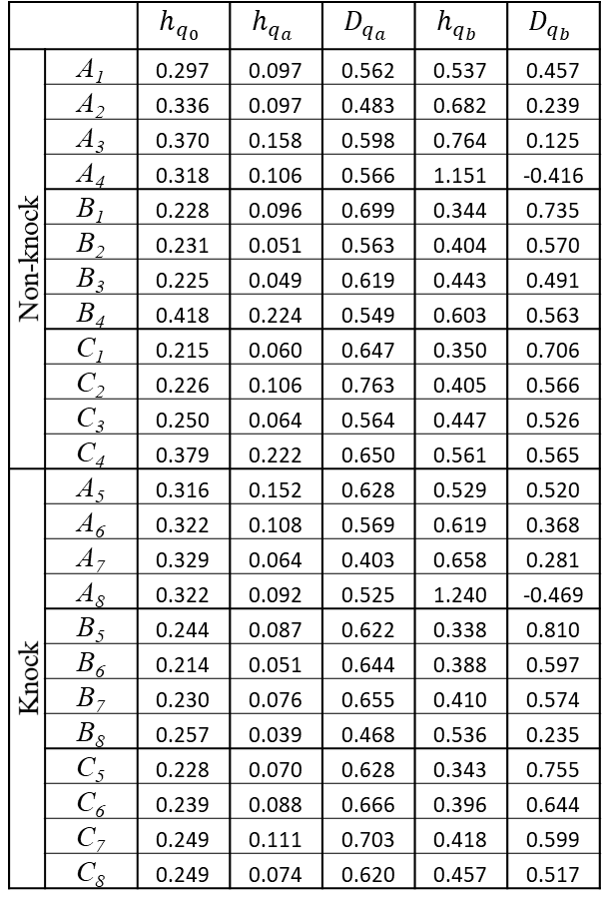
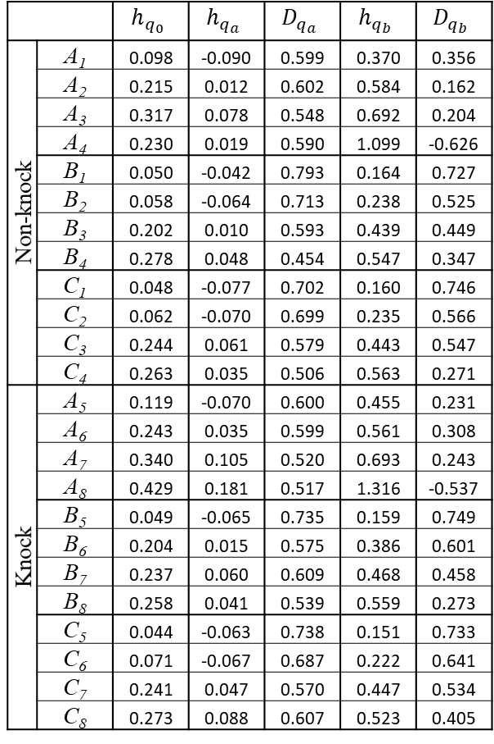
EEMD + Sample entropy
OVMD + Sample entropy
 |  | $$h_{q_{0}}$$ | $$h_{q_{a}}$$ | $$D_{q_{a}}$$ | $$h_{q_{b}}$$ | $$D_{q_{b}}$$
Non-knock | A₁ | 0.297 | 0.097 | 0.562 | 0.537 | 0.457
 | A₂ | 0.336 | 0.097 | 0.483 | 0.682 | 0.239
 | A₃ | 0.370 | 0.158 | 0.598 | 0.764 | 0.125
 | A₄ | 0.318 | 0.106 | 0.566 | 1.151 | -0.416
 | B₁ | 0.228 | 0.096 | 0.699 | 0.344 | 0.735
 | B₂ | 0.231 | 0.051 | 0.563 | 0.404 | 0.570
 | B₃ | 0.225 | 0.049 | 0.619 | 0.443 | 0.491
 | B₄ | 0.418 | 0.224 | 0.549 | 0.603 | 0.563
 | C₁ | 0.215 | 0.060 | 0.647 | 0.350 | 0.706
 | C₂ | 0.226 | 0.106 | 0.763 | 0.405 | 0.566
 | C₃ | 0.250 | 0.064 | 0.564 | 0.447 | 0.526
 | C₄ | 0.379 | 0.222 | 0.650 | 0.561 | 0.565
Knock | A₅ | 0.316 | 0.152 | 0.628 | 0.529 | 0.520
 | A₆ | 0.322 | 0.108 | 0.569 | 0.619 | 0.368
 | A₇ | 0.329 | 0.064 | 0.403 | 0.658 | 0.281
 | A₈ | 0.322 | 0.092 | 0.525 | 1.240 | -0.469
 | B₅ | 0.244 | 0.087 | 0.622 | 0.338 | 0.810
 | B₆ | 0.214 | 0.051 | 0.644 | 0.388 | 0.597
 | B₇ | 0.230 | 0.076 | 0.655 | 0.410 | 0.574
 | B₈ | 0.257 | 0.039 | 0.468 | 0.536 | 0.235
 | C₅ | 0.228 | 0.070 | 0.628 | 0.343 | 0.755
 | C₆ | 0.239 | 0.088 | 0.666 | 0.396 | 0.644
 | C₇ | 0.249 | 0.111 | 0.703 | 0.418 | 0.599
 | C₈ | 0.249 | 0.074 | 0.620 | 0.457 | 0.517
 |  | $$h_{q_{0}}$$ | $$h_{q_{a}}$$ | $$D_{q_{a}}$$ | $$h_{q_{b}}$$ | $$D_{q_{b}}$$
Non-knock | A₁ | 0.098 | -0.090 | 0.599 | 0.370 | 0.356
 | A₂ | 0.215 | 0.012 | 0.602 | 0.584 | 0.162
 | A₃ | 0.317 | 0.078 | 0.548 | 0.692 | 0.204
 | A₄ | 0.230 | 0.019 | 0.590 | 1.099 | -0.626
 | B₁ | 0.050 | -0.042 | 0.793 | 0.164 | 0.727
 | B₂ | 0.058 | -0.064 | 0.713 | 0.238 | 0.525
 | B₃ | 0.202 | 0.010 | 0.593 | 0.439 | 0.449
 | B₄ | 0.278 | 0.048 | 0.454 | 0.547 | 0.347
 | C₁ | 0.048 | -0.077 | 0.702 | 0.160 | 0.746
 | C₂ | 0.062 | -0.070 | 0.699 | 0.235 | 0.566
 | C₃ | 0.244 | 0.061 | 0.579 | 0.443 | 0.547
 | C₄ | 0.263 | 0.035 | 0.506 | 0.563 | 0.271
Knock | A₅ | 0.119 | -0.070 | 0.600 | 0.455 | 0.231
 | A₆ | 0.243 | 0.035 | 0.599 | 0.561 | 0.308
 | A₇ | 0.340 | 0.105 | 0.520 | 0.693 | 0.243
 | A₈ | 0.429 | 0.181 | 0.517 | 1.316 | -0.537
 | B₅ | 0.049 | -0.065 | 0.735 | 0.159 | 0.749
 | B₆ | 0.204 | 0.015 | 0.575 | 0.386 | 0.601
 | B₇ | 0.237 | 0.060 | 0.609 | 0.468 | 0.458
 | B₈ | 0.258 | 0.041 | 0.539 | 0.559 | 0.273
 | C₅ | 0.044 | -0.063 | 0.738 | 0.151 | 0.733
 | C₆ | 0.071 | -0.067 | 0.687 | 0.222 | 0.641
 | C₇ | 0.241 | 0.047 | 0.570 | 0.447 | 0.534
 | C₈ | 0.273 | 0.088 | 0.607 | 0.523 | 0.405

